Slide 1
Decision Tree
A supervised machine learning algorithm used for classification and regression.

Slide 2
Suppose a bank wants to decide whether to approve a loan.
IF Income > 50k
approve loan
ELSE
reject
This is exactly what a Decision Tree learns.

Slide 3
Decision Tree
A supervised machine learning algorithm used for: • Classification and Regression Key idea: The model learns a set of decision rules in the form of IF–ELSE conditions. Advantages • Easy to understand • Highly interpretable • Handles non-linear data • Works with numerical and categorical data

Slide 4
Why do companies like decision trees?
Because humans can understand them.

Slide 5
Decision Tree Algorithm
ID3 → Uses Entropy
C4.5 → Uses Gain Ratio
CART → Uses Gini Index (Classification and Regression Tree).

Slide 6
Approach in Decision Tree Algorithm:
Step 1: Start with the entire dataset at the root node.
Step 2 : Evaluate all features to find the best split.
Step 3: Split the dataset based on the feature that gives maximum information gain (or minimum impurity).
Step 4: Repeat the process recursively for each branch.
Step 5: Stop splitting when a stopping condition is met.

Slide 7
Example: Loan Approval
Root node question : Income > 50k ?
YES → Approve loan
NO → Check credit score
A decision tree keeps asking questions about features until it can make a decision.

Slide 8
Suppose we want to predict whether a student plays cricket.
Dataset:
Target= Play Cricket
Total Students = 30
Yes : 15
No : 15
Which question should we ask first?
Gender? Height? Class?
Decision Tree checks all options and chooses the best one.

Slide 9
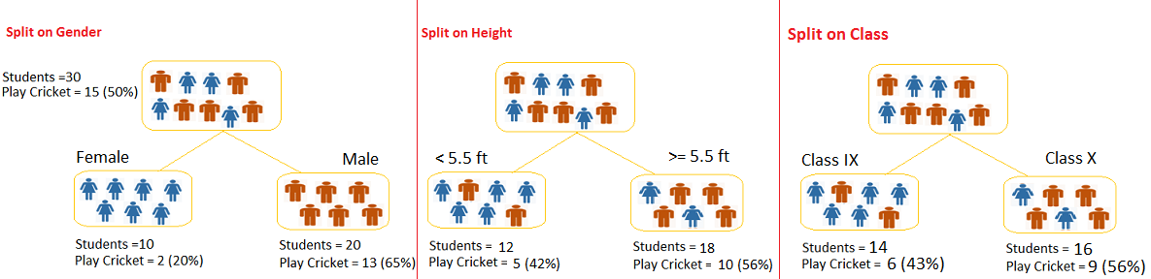

Slide 10
Decision Tree selects the feature that gives the BEST split : using Gini or Entropy.

Slide 11
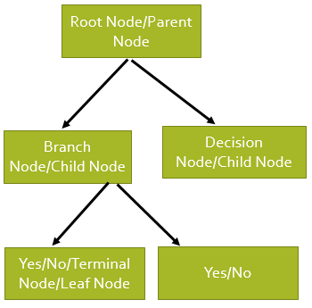
Structure of Decision Tree
Root Node
First node of the tree
Represents the entire dataset
Decision Node
A node where the dataset is split
Based on a feature condition
Branch
Outcome of the decision rule
Leaf Node
Final node
Represents the predicted class

Slide 12
Income > 50k
/ \
YES NO
Approve Credit Score > 700
/ \
YES NO
Approve Reject

Slide 13
Impurity Measures in Decision Trees
Gini Index
Gini = 1 − (p² + q²)
p → probability of class 1
q → probability of class 2
Entropy
Entropy = − p log₂(p) − q log₂(q)
Information Gain
Information Gain = Entropy(parent) − Weighted Entropy(children)

Slide 14
How does tree decide where to split
Lower Gini → Better split
Entropy Index → Measures uncertainty in the data

Slide 15
Gini Interpretation
Gini | Meaning
0 | Pure node
High | Impure
Lower Gini → better split
Higher Gini → more impurity

Slide 16
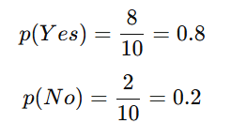
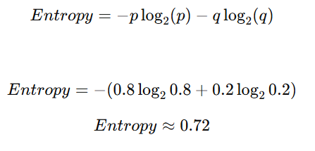
Example:
Node contains : 8 = Yes, 2 = No
Probability :
Case | Distribution | Entropy | Meaning
Pure node | 10 Yes, 0 No | 0 | Perfect certainty
Balanced | 5 Yes, 5 No | 1 | Maximum uncertainty
Almost pure | 8 Yes, 2 No | 0.72 | Moderate impurity
Entropy is lower than the maximum value (1), indicating some class dominance, but the node is not perfectly pure.
Entropy is moderate because one class dominates but both classes are still present.

Slide 17
Let us understand the algorithm:

Slide 18
Iris dataset : Each class contains 50 samples.
Total Samples: 150
Features: 4
Sepal Length (cm)
Sepal Width (cm)
Petal Length (cm)
Petal Width (cm)

Slide 19
Setosa → easily separable Versicolor & Virginica → overlap
Target Classes: 3
Setosa,
Versicolor,
Virginica

Slide 20
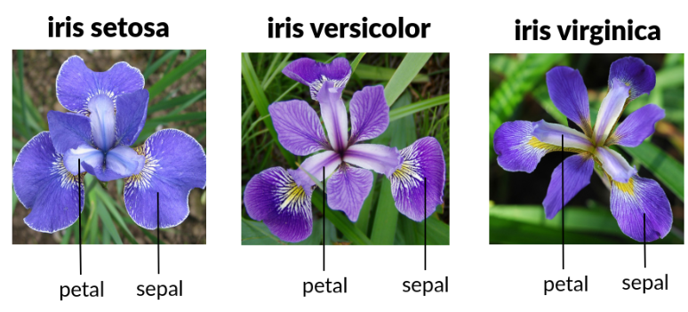

Slide 21
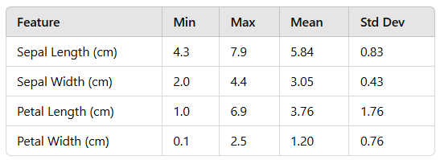

Slide 22
Let us use to make model: Nested if else method: where xi = {SL,SW,PL,PW}

Slide 23
If Petal Length(PL) < a
Yi = 1
Else
if Sepal Length(SL) < b
Yi = 2
Else
Yi = 3
Decision Tree as Nested IF-ELSE Rules

Slide 24
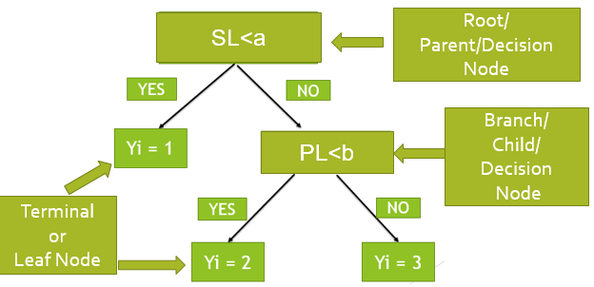
Decision Tree Representation of Nested if else condition

Slide 25
Structure of the Tree
At Root Node:
If Sepal Length ≤ 5.5, go left. Else, go right.
Left Child: (The left child corresponds to the true or yes branch of a decision split.)
If Petal Length ≤ 3.0, go left. Else, go right.

Slide 26
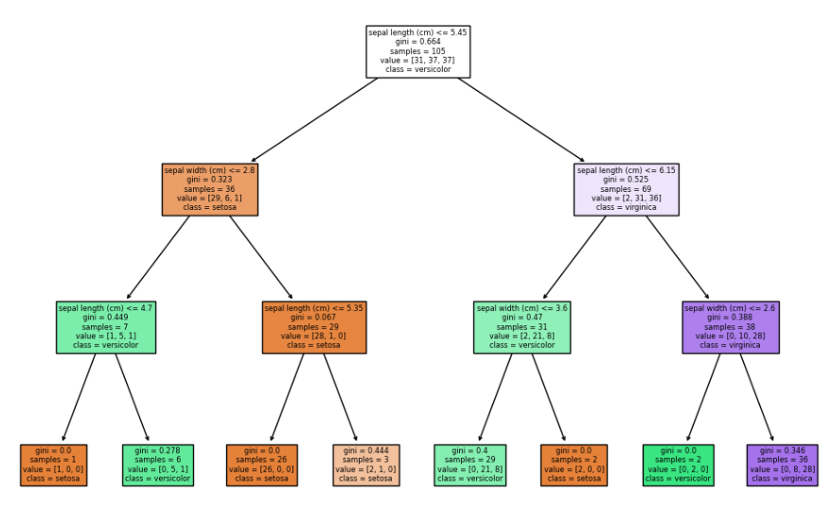
Graphical view of a Decision Tree

Slide 27
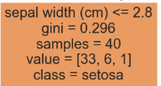
Samples:
The total number of samples (data points) at that node.
Example: The root node has 40 samples.
Value:
A count of samples from each class at that node.
Example: At the root node, value=[33,6,1]:
33 samples belong to class setosa,
6 to versicolor,
1 to virginica.
Class:
The majority class at that node.
For instance, the root node predicts setosa as the majority class.

Slide 28
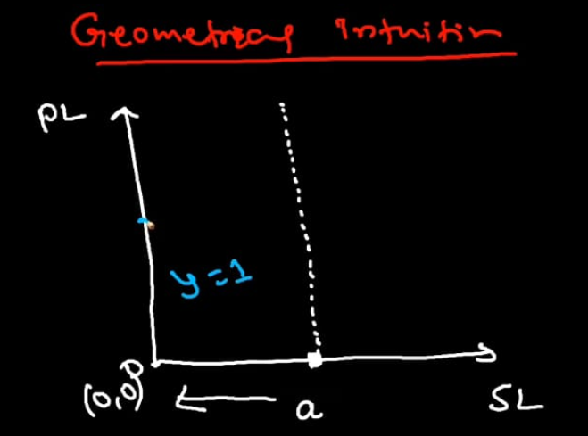
Geometrical Intuition of Decision Trees Axis-Parallel Splits
A decision tree splits data using only one feature at a time.
Each split creates a boundary that is parallel to one of the feature axes.
Example:
Iris Dataset:
Sepal Length (SL) along x axis
Petal Length(PL) along y axis
Split condition: Sepal Length ≤ 5.5 This creates a vertical line in feature space.

Slide 29
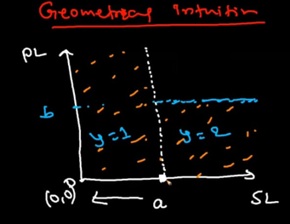
Next split: Petal Width ≤ 2.5
This creates a horizontal line.
Therefore boundaries are parallel to axes.

Slide 30
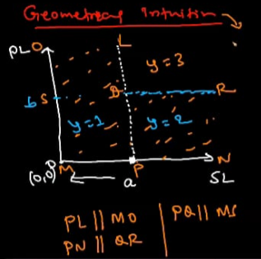
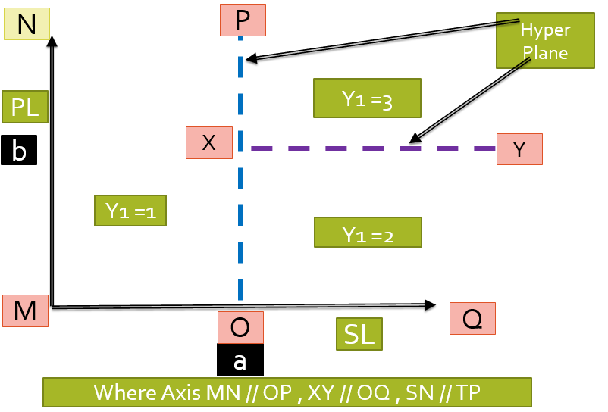

Slide 31
Decision trees cannot draw diagonal boundaries and Decision tree splits create axis-parallel decision boundaries in feature space.
Decision trees approximate complex decision boundaries using multiple rectangular regions.
So:
Decision tree is an axis parallel model.
It is a nested if else condition.

Slide 32
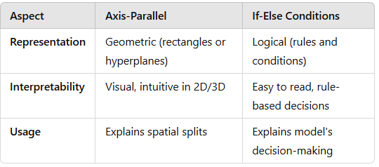
Differences Between Axis-Parallel and If-Else

Slide 33
How to decide root node: Decision Tree
Approach 1: Criterion = Gini Index : By default in model
Approach 2 : Criterion = Entropy or Information gain

Slide 34
Step 1: Start at the root node, which contains the entire dataset.
Step 2: Find the feature that best splits the dataset into groups based on the target variable.
The "best split" is often calculated using metrics like Gini Index, Information Gain (Entropy), or Variance Reduction.

Slide 35
Gini Index vs Entropy
Gini Index
Entropy
Formula:
Gini = 1 − Σ (p_i²)
Measures the impurity of a node.
Properties:
Gini = 0 → Pure node
Higher Gini → More impurity
Formula:
Entropy = − Σ p_i log₂(p_i)
Measures uncertainty in the dataset.
Properties:
Entropy = 0 → Pure node
Entropy = 1 → Maximum uncertainty

Slide 36
Key Difference
Criteria | Gini | Entropy
Used in | CART | ID3 / C4.5
Speed | Faster | Slightly slower
Interpretation | Impurity | Information uncertainty

Slide 37
Gini Index
Target variable: Success or Failure
CART decision trees typically use binary splits.
To determine the root node variable using the Gini Index, we calculate the Gini Impurity before and after each split and select the split that gives the highest reduction in impurity (also known as Gini Gain).
Lower Gini → More pure node
Higher Gini → More impurity

Slide 38
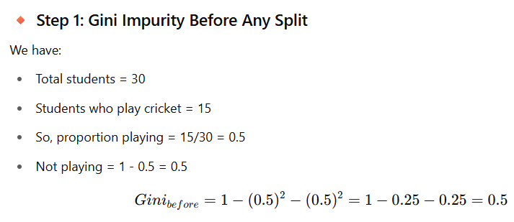

Slide 39

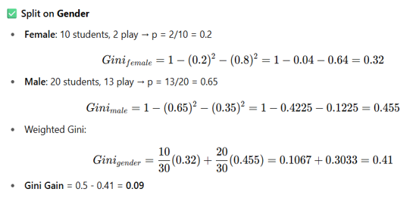

Slide 40
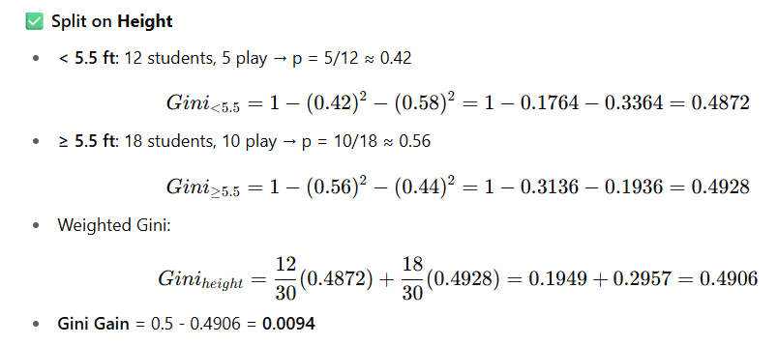

Slide 41
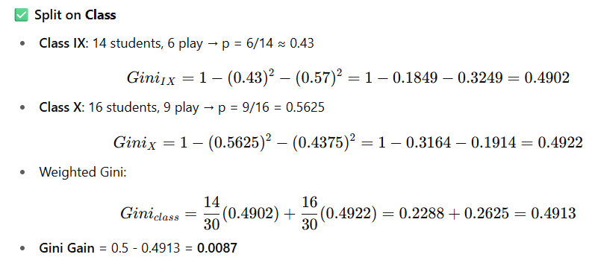

Slide 42
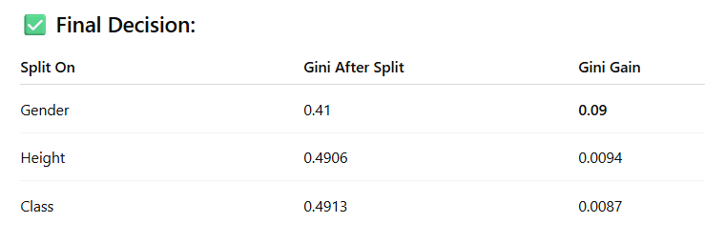
Root Node Should Split on: Gender (Highest Gini Gain = 0.09)

Slide 43
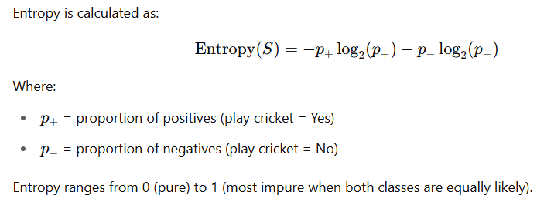
Entropy

Slide 44

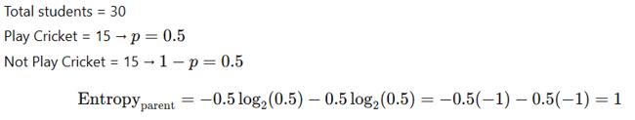

Slide 45

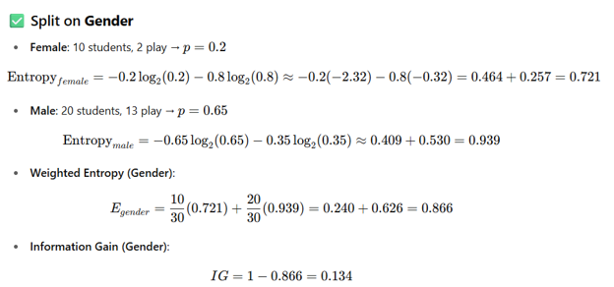

Slide 46
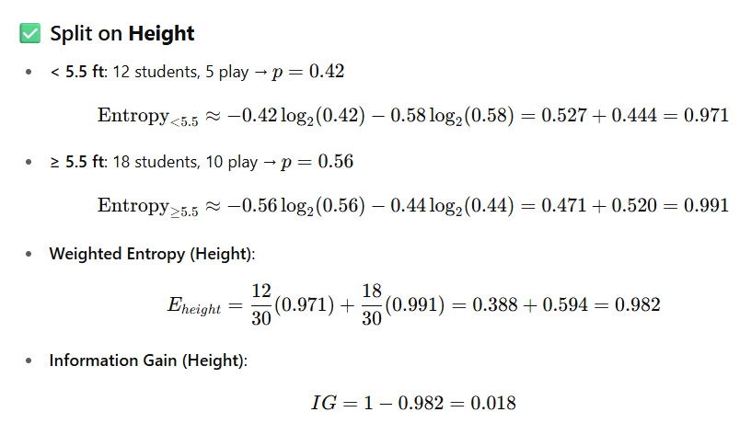

Slide 47
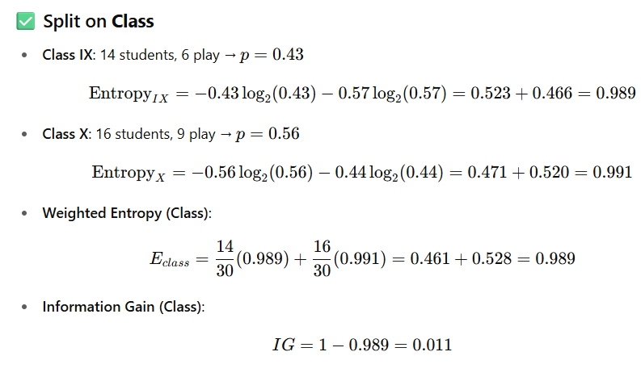

Slide 48
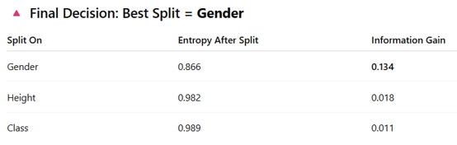
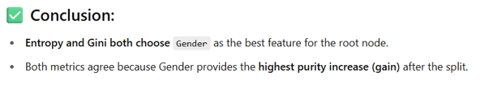

Slide 49
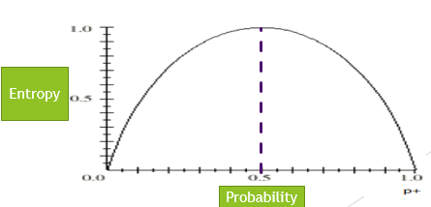
Properties of Entropy
Case 1: for p = 0 or 1 , Entropy is close to zero = Perfect certainty
Case 2: For p = 0.5 , Entropy is almost 1. = Maximum Uncertainty

Slide 50
Which node is easier to classify?
Node A
9 Yes
1 No
Node B
5 Yes
5 No
Node A → lower entropy
Node B → higher entropy

Slide 51
When to Use Which?
Use Case | Recommended Metric
large datasets | Gini
When interpretability matters | Entropy
CART | Gini
If you use ID3 or C4.5 | Entropy

Slide 52
Gini: Thinks in terms of "how likely is it to be wrong?" (error-based).(Categorical Variables)
Entropy: Thinks in terms of "how much information is needed to describe the system?" (uncertainty-based).(for Numerical variables)
Feature Type | Gini Index / Entropy Handling
Categorical | Directly compute impurity for each category-based split (e.g., Gender)
Numerical | Require a threshold-based split (e.g., Height < 5.5, Age > 30)

Slide 53
Example to understand Entropy and Gini concept for selecting root node in Decision Tree.

Slide 54
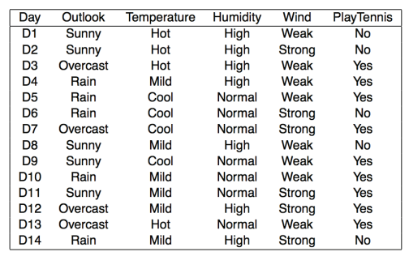
Problem Statement: To determine whether or not to play tennis based on weather conditions.

Slide 55
Features | TOTAL =14 | Yes = 9 | No = 5
Out Look | Sunny = 5 | 2 | 3
 | Over Cast = 4 | 4 | 0
 | Rainy = 5 | 3 | 2
Temperature | Hot = 4 | 2 | 2
 | Cold = 4 | 3 | 1
 | Mild = 6 | 4 | 2
Humidity | High = 7 | 3 | 4
 | Normal = 7 | 6 | 1
Wind | Weak= 8 | 2 | 6
 | Strong = 6 | 3 | 3

Slide 56
Step 1: Calculate the Gini Index of the Target (PlayTennis):
Gini = 1-[ P(Yes)**2+P(No)**2]
= 1 – [(9/14)**2 + (5/14)**2]
= 1 – [(0.64)**2 + (0.36)**2]
= 1 –[0.41+0.13]
= 1- 0.54 --->> 0.46

Slide 57
Step 2: Calculate Gini for each feature
Feature: Outlook , Sub Feature: Sunny , Overcast, Rainy
Sunny ---> yes = 2 ,No = 3 , Total = 5
Gini = 1-[ P(Yes)**2+P(No)**2]
= 1 – [(2/5)**2 + (3/5)**2]
= 1 – [(0.4)**2 + (0.6)**2]
= 1 –[.16 +.36]
= 1- 0.52 --->> 0.48

Slide 58
Overcast ---> yes = 4 ,No = 0 , Total = 4
Gini = 1-[ P(Yes)**2+P(No)**2]
= 1 – [(4/4)**2 + (0/4)**2]
= 1 – [(1)**2 + (0.0)**2]
= 1 –[1+ 0]
= 1- 1 --->> 0

Slide 59
Rainy ---> yes = 3 ,No = 2 , Total = 5
Gini = 1-[ P(Yes)**2+P(No)**2]
= 1 – [(3/5)**2 + (2/5)**2]
= 1 – [(0.6)**2 + (0.4)**2]
= 1 –[.36+ .16]
= 1- 0.52 --->> 0.48

Slide 60
Weighted Gini for Outlook
I(outlook) = (No of yes for Sunny/total)*(Gini calculated for Sunny)
+ (No of yes for Overcast/total)*(Gini calculated for Overcast)
+ (No of yes for Rainy/total)*(Gini calculated for Rainy)
= (5/14)*(0.48) +(4/14)*0 + (5/14)*(.48)
= (0.357)*(0.48) +0 + (0.357)*(0.48)
= 0.171 + 0 + 0.171 = 0.343
This is an Weighted Gini which will be used for Information gain

Slide 61
Feature: Temperature , Sub Feature: Hot, Cold, Mild
Hot ==>> Total = 4, Yes = 2 , No = 2
Gini = 1-[ P(Yes)**2+P(No)**2]
= 1 – [(2/4)**2 + (2/4)**2]
= 1 – [(0.5)**2 + (0.5)**2]
= 1 –[.25 +.25]
= 1- 0.5 --->> 0.5

Slide 62
Cold ==>> Total = 4, Yes = 3 , No = 1
Gini = 1-[ P(Yes)**2+P(No)**2]
= 1 – [(3/4)**2 + (1/4)**2]
= 1 – [(0.75)**2 + (0.25)**2]
= 1 –[.56 +.06]
= 1- 0.62 --->> 0.38

Slide 63
Mild ==>> Total = 6, Yes = 4 , No = 2
Gini = 1-[ P(Yes)**2+P(No)**2]
= 1 – [(4/6)**2 + (2/6)**2]
= 1 – [(0.67)**2 + (0.33)**2]
= 1 –[0.45 +0.11]
= 1- 0.56 --->> 0.44

Slide 64
Weighted Gini for Temperature
I(Temperature) = (No of yes for Hot/total)*(Gini calculated for Hot)
+ (No of yes for Cold/total)*(Gini calculated for Cold)
+ (No of yes for Mild/total)*(Gini calculated for MIld)
= (4/14)*(0.5) +(4/14)*0.38 + (6/14)*(0.44)
= (0.29)*(0.5) + (0.29)*(0.38) + (0.43)*(0.44)
= 0.145 + 0.11 + 0.189 = 0.444
This is an Weighted Gini which will be used for Information gain

Slide 65
Feature: Humidity , Sub Feature: High, Normal
High ==>> Total = 7, Yes = 3 , No = 4
Gini = 1-[ P(Yes)**2+P(No)**2]
= 1 – [(3/7)**2 + (4/7)**2]
= 1 – [(0.43)**2 + (0.57)**2]
= 1 –[0.18 +0.33]
= 1- 0.51 --->> 0.49

Slide 66
Normal ==>> Total = 7, Yes = 6 , No = 1
Gini = 1-[ P(Yes)**2+P(No)**2]
= 1 – [(6/7)**2 + (1/7)**2]
= 1 – [(0.86)**2 + (0.14)**2]
= 1 –[0.74 +0.02]
= 1- 0.76 --->> 0.24

Slide 67
Weighted Gini for Humidity
I(Humidity) = (No of yes for High/total)*(Gini calculated for High)
+ (No of yes for Normal/total)*(Gini calculated for Normal)
= (7/14)*(0.49) +(7/14)*.24
= (0.5)*(0.49) + (0.5)*(0.24)
= 0.245 + 0.120 = 0.365
This is an Weighted Gini which will be used for Information gain

Slide 68
Feature: Wind , Sub Feature: Strong ,Weak
Strong ==>> Total = 6, Yes = 3 , No = 3
Gini = 1-[ P(Yes)**2+P(No)**2]
= 1 – [(3/6)**2 + (3/6)**2]
= 1 – [(0.5)**2 + (0.5)**2]
= 1 –[.25 +.25]
= 1- 0.5 --->> 0.5

Slide 69
Weak ==>> 8 Total = 8, Yes = 6 , No = 2
Gini = 1-[ P(Yes)**2+P(No)**2]
= 1 – [(6/8)**2 + (2/8)**2]
= 1 – [(0.75)**2 + (0.25)**2]
= 1 –[.562 +.0625]
= 1- 0.623 --->> 0.37

Slide 70
Weighted Gini for Wind
I(Wind) = (No of yes for Strong/total)*(Gini calculated for Strong)
+ (No of yes for Weak/total)*(Gini calculated for Weak)
= (6/14)*(0.5) +(8/14)*(.37)
= (0.43)*(0.5) + (0.57)*(0.37)
= 0.214 + 0.211 = 0.425
This is an Weighted Gini which will be used for Information gain

Slide 71
Features | Weighted Gini | Information Gain (Parent – Weighted)
Outlook | 0.343 | 0.46 – 0.343 = 0.117
Temperature | 0.44 | 0.46 – 0.44 = 0.02
Humidity | 0.37 | 0.46 – 0.37 = 0.09
Wind | 0.425 | 0.46 – 0.425 = 0.036
* So now we see that OUTLOOK has maximum Information gain So it will be taken as root node for splitting based on Gini criterion.

Slide 72
Let us do all this with Entropy Approach

Slide 73
Features | TOTAL =14 | Yes = 9 | No = 5
Out Look | Sunny = 5 | 2 | 3
 | Over Cast = 4 | 4 | 0
 | Rainy = 5 | 3 | 2
Temperature | Hot = 4 | 2 | 2
 | Cold = 4 | 3 | 1
 | Mild = 6 | 4 | 2
Humidity | High = 7 | 3 | 4
 | Normal = 7 | 6 | 1
Wind | Weak= 8 | 2 | 6
 | Strong = 6 | 3 | 3

Slide 74
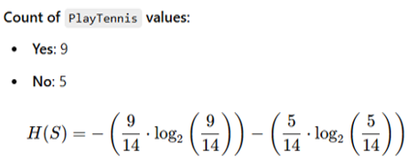
Step 1: Calculate the Entropy of the Target (PlayTennis)
= -[(0.64)*(-0.637) +(0.357)*(-1.485)]
= -[-0.407-0.53] = [0.937]

Slide 75
Step 2: Calculate Information Gain for Each Feature
For each attribute (Outlook, Temperature, Humidity, Wind), calculate the weighted entropy for each value, then subtract it from the entropy of the target.

Slide 76
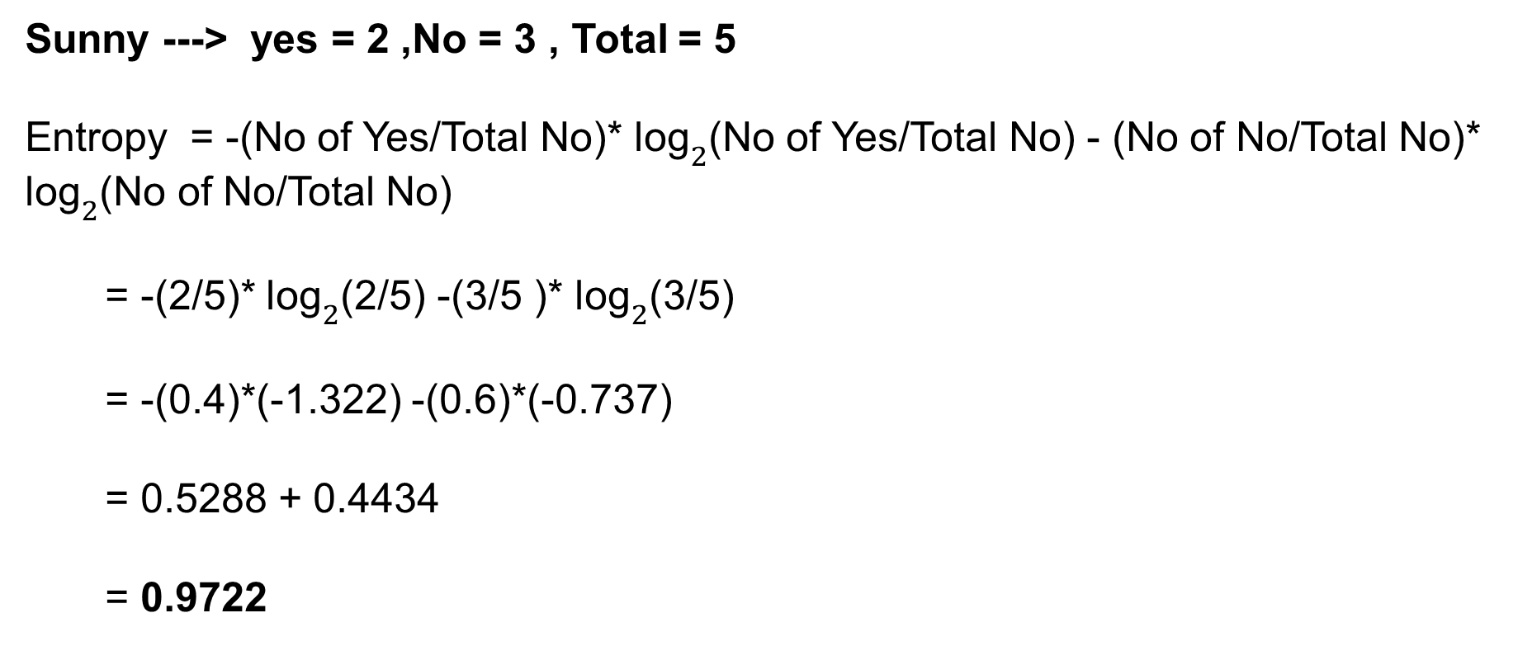
Feature: Outlook , Sub Feature: Sunny , Overcast, Rainy
Sunny ---> yes = 2 ,No = 3 , Total = 5
Entropy = -(No of Yes/Total No)* ${\text{log}}_{2}$(No of Yes/Total No) - (No of No/Total No)* ${\text{log}}_{2}$(No of No/Total No)
= -(2/5)* ${\text{log}}_{2}$(2/5) -(3/5 )* ${\text{log}}_{2}$(3/5)
= -(0.4)*(-1.322) -(0.6)*(-0.737)
= 0.5288 + 0.4434
= 0.9722

Slide 77
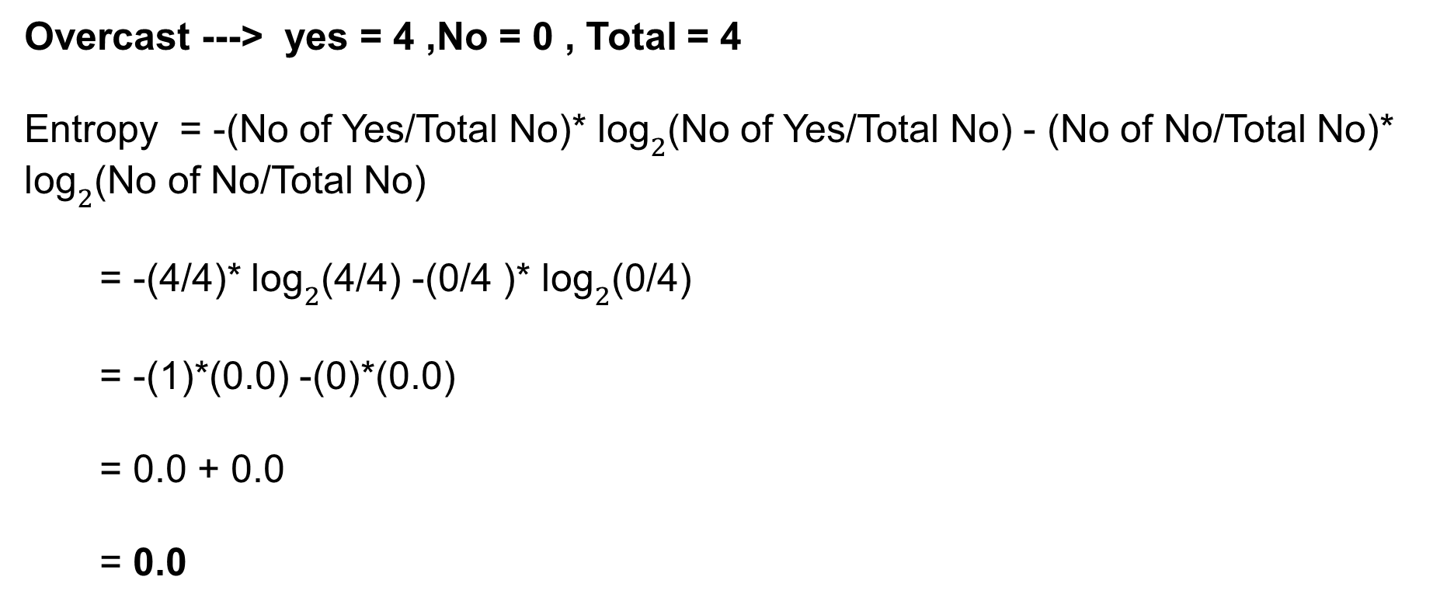
Overcast ---> yes = 4 ,No = 0 , Total = 4
Entropy = -(No of Yes/Total No)* ${\text{log}}_{2}$(No of Yes/Total No) - (No of No/Total No)* ${\text{log}}_{2}$(No of No/Total No)
= -(4/4)* ${\text{log}}_{2}$(4/4) -(0/4 )* ${\text{log}}_{2}$(0/4)
= -(1)*(0.0) -(0)*(0.0)
= 0.0 + 0.0
= 0.0

Slide 78
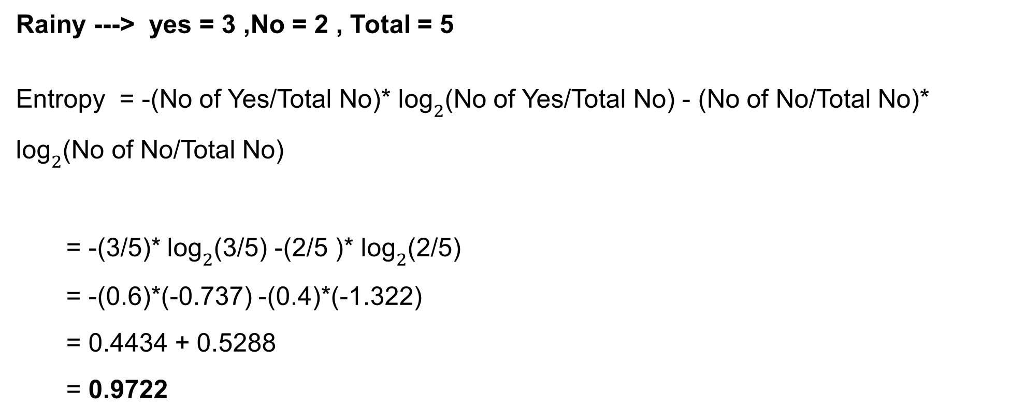
Rainy ---> yes = 3 ,No = 2 , Total = 5
Entropy = -(No of Yes/Total No)* ${\text{log}}_{2}$(No of Yes/Total No) - (No of No/Total No)* ${\text{log}}_{2}$(No of No/Total No)
= -(3/5)* ${\text{log}}_{2}$(3/5) -(2/5 )* ${\text{log}}_{2}$(2/5)
= -(0.6)*(-0.737) -(0.4)*(-1.322)
= 0.4434 + 0.5288
= 0.9722

Slide 79
Weighted Entropy for Outlook
I(outlook) = (No of yes for Sunny/total)*(Entropy calculated for Sunny)
+ (No of yes for Overcast/total)*(Entropy calculated for Overcast)
+ (No of yes for Rainy/total)*(Entropy calculated for Rainy)
= (5/14)*(0.9722) +(4/14)*0 + (5/14)*(.9722)
= (0.357)*(0.9722) + 0 + (0.357)*(0.9722)
= 0.347 + 0 + 0.347 = 0.694
This is an Weighted Entropy which will be used for Information gain

Slide 80
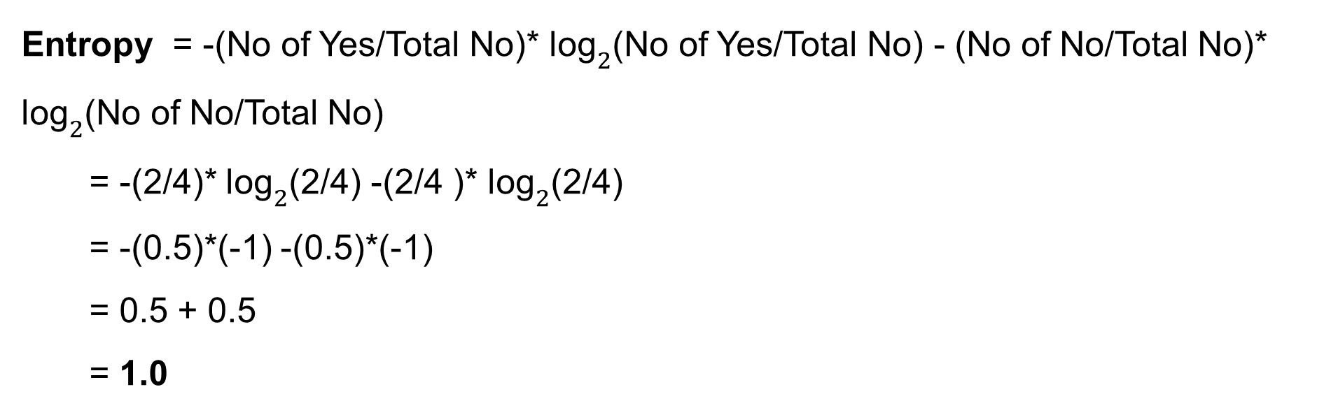
Feature: Temperature , Sub Feature: Hot, Cold, Mild
Hot ==>> Total = 4, Yes = 2 , No = 2
Entropy = -(No of Yes/Total No)* ${\text{log}}_{2}$(No of Yes/Total No) - (No of No/Total No)* ${\text{log}}_{2}$(No of No/Total No)
= -(2/4)* ${\text{log}}_{2}$(2/4) -(2/4 )* ${\text{log}}_{2}$(2/4)
= -(0.5)*(-1) -(0.5)*(-1)
= 0.5 + 0.5
= 1.0

Slide 81

Cold ==>> Total = 4, Yes = 3 , No = 1
Entropy = -(No of Yes/Total No)* ${\text{log}}_{2}$(No of Yes/Total No) - (No of No/Total No)* ${\text{log}}_{2}$(No of No/Total No)
= -(3/4)* ${\text{log}}_{2}$(3/4) -(1/4 )* ${\text{log}}_{2}$(1/4)
= -(0.75)*(-0.411) -(0.25)*(-2.0)
= 0.308 + 0.5
= 0.8308

Slide 82

Mild ==>> Total = 6, Yes = 4 , No = 2
Entropy = -(No of Yes/Total No)* ${\text{log}}_{2}$(No of Yes/Total No) - (No of No/Total No)* ${\text{log}}_{2}$(No of No/Total No)
= -(4/6)* ${\text{log}}_{2}$(4/6) -(2/6 )* ${\text{log}}_{2}$(2/6)
= -(0.66)*(-0.585) -(0.33)*(-1.585)
= 0.39 + 0.5283
= 0.91

Slide 83
Weighted Entropy for Temperature
I(Temperature) = (No of yes for Hot/total)*(Entropy calculated for Hot)
+ (No of yes for Cold/total)*(Entropy calculated for Cold)
+ (No of yes for Mild/total)*(Entropy calculated for Mild)
= (4/14)*(1) +(3/14)*0.8308 + (4/14)*(0.91)
= (0.285)*(1) + (0.214)*(0.8308) + (0.285)*(0.91)
= 0.285 + 0.177 + 0.26 = 0.722
This is an Weighted Entropy which will be used for Information gain

Slide 84
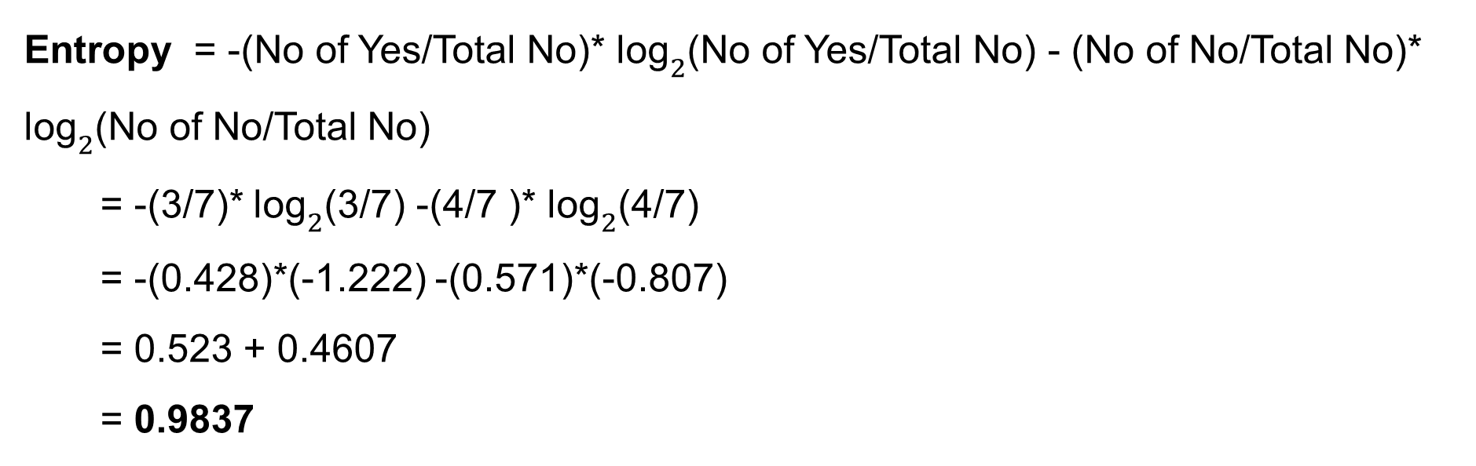
Feature: Humidity , Sub Feature: High, Normal
High ==>> Total = 7, Yes = 3 , No = 4
Entropy = -(No of Yes/Total No)* ${\text{log}}_{2}$(No of Yes/Total No) - (No of No/Total No)* ${\text{log}}_{2}$(No of No/Total No)
= -(3/7)* ${\text{log}}_{2}$(3/7) -(4/7 )* ${\text{log}}_{2}$(4/7)
= -(0.428)*(-1.222) -(0.571)*(-0.807)
= 0.523 + 0.4607
= 0.9837

Slide 85
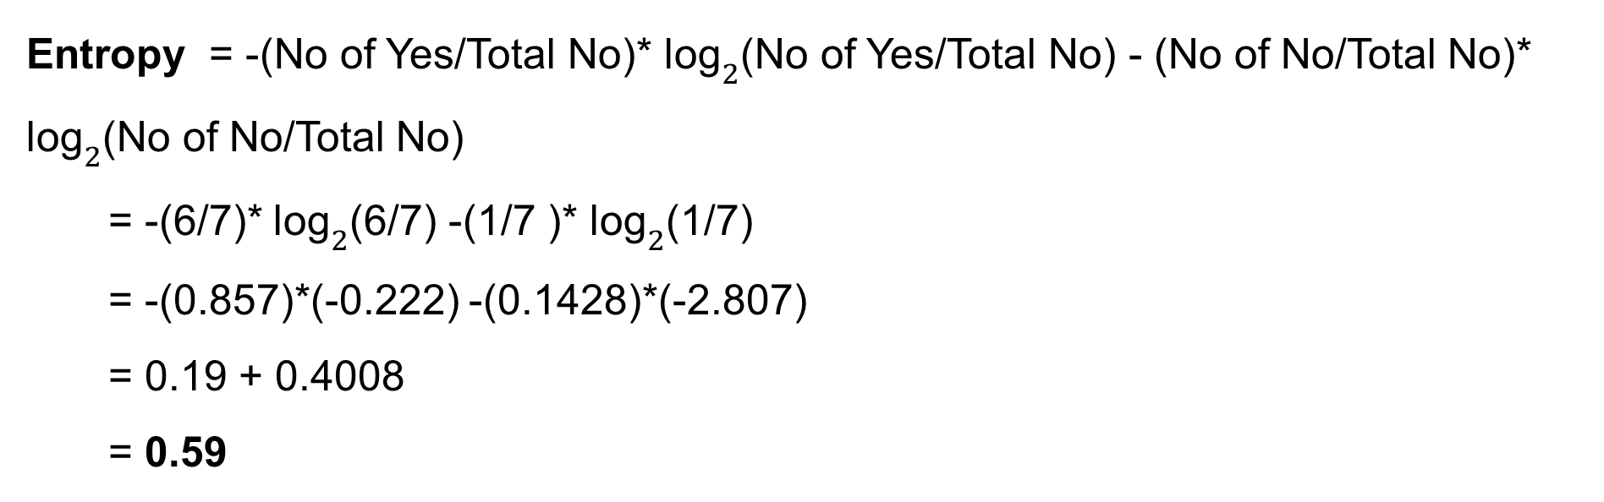
Normal ==>> Total = 7, Yes = 6 , No = 1
Entropy = -(No of Yes/Total No)* ${\text{log}}_{2}$(No of Yes/Total No) - (No of No/Total No)* ${\text{log}}_{2}$(No of No/Total No)
= -(6/7)* ${\text{log}}_{2}$(6/7) -(1/7 )* ${\text{log}}_{2}$(1/7)
= -(0.857)*(-0.222) -(0.1428)*(-2.807)
= 0.19 + 0.4008
= 0.59

Slide 86
Weighted Entropy for Humidity
I(Humidity) = (No of yes for High/total)*(Entropy calculated for High)
+ (No of yes for Normal/total)*(Entropy calculated for Normal)
= (7/14)*(0.9837) +(7/14)*(0.59)
= (0.5)*(0.9837) + (0.5)*(0.59)
= 0.4918 + 0.295 = 0.7868
This is an Weighted Entropy which will be used for Information gain

Slide 87
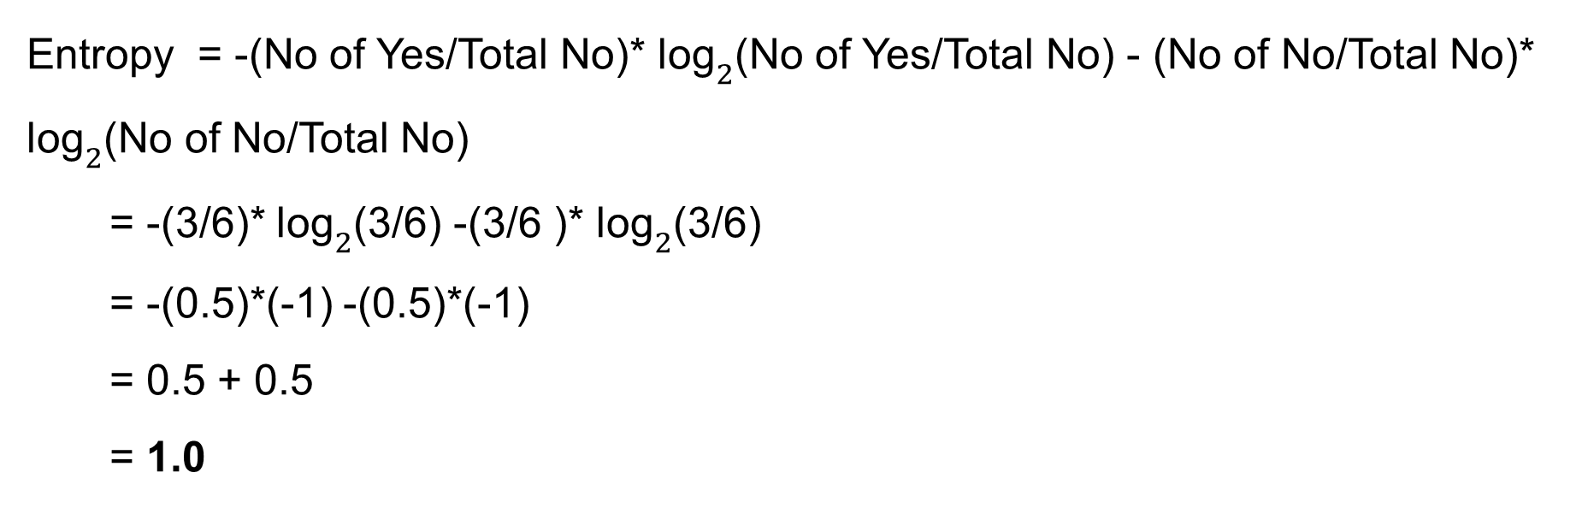
Feature: Wind , Sub Feature: Strong ,Weak
Strong ==>> Total = 6, Yes = 3 , No = 3
Entropy = -(No of Yes/Total No)* ${\text{log}}_{2}$(No of Yes/Total No) - (No of No/Total No)* ${\text{log}}_{2}$(No of No/Total No)
= -(3/6)* ${\text{log}}_{2}$(3/6) -(3/6 )* ${\text{log}}_{2}$(3/6)
= -(0.5)*(-1) -(0.5)*(-1)
= 0.5 + 0.5
= 1.0

Slide 88
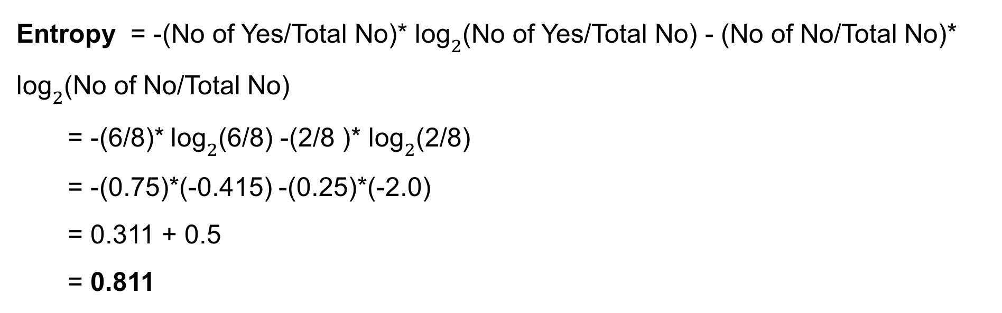
Weak ==>> 8 Total = 8, Yes = 6 , No = 2
Entropy = -(No of Yes/Total No)* ${\text{log}}_{2}$(No of Yes/Total No) - (No of No/Total No)* ${\text{log}}_{2}$(No of No/Total No)
= -(6/8)* ${\text{log}}_{2}$(6/8) -(2/8 )* ${\text{log}}_{2}$(2/8)
= -(0.75)*(-0.415) -(0.25)*(-2.0)
= 0.311 + 0.5
= 0.811

Slide 89
Weighted Entropy for Wind
I(Wind) = (No of yes for Strong/total)*(Entropy calculated for Strong)
+ (No of yes for Weak/total)*(Entropy calculated for Weak)
= (6/14)*(1.0) +(8/14)*(.811)
= (0.43)*(1.0) + (0.57)*(0.811)
= 0.43 + 0.462 = 0.892
This is an Weighted Entropy which will be used for Information gain

Slide 90
Features | Weighted Entropy | Information Gain (Parent – Weighted)
Outlook | 0.694 | 0.937 – 0.694 = 0.243
Temperature | 0.722 | 0.937 – 0.722 = 0.215
Humidity | 0.7868 | 0.937 – 0.7868 = 0.1502
Wind | 0.892 | 0.937 – 0.892 = 0.045
* So now we see that OUTLOOK has maximum Information gain So it will be taken as root node for splitting based on Entropy criterion.

Slide 91
Over Fitting in Decision Tree
Decision trees can easily overfit the training data as the depth of the tree increases.
Overfitting occurs when the tree learns: • Patterns • Noise • Outliers
This leads to very high training accuracy but poor test accuracy.
Deep Tree → Overfitting
Shallow Tree → Under fitting

Slide 92
How to Control Overfitting
Techniques to Prevent Overfitting
Limit Tree Depth (max_depth)
Minimum Samples Required to Split (min_samples_split)
Minimum Samples per Leaf (min_samples_leaf)
Pruning : As a rule of thumb, keep the depth equal to or slightly greater than the number of features.
Cross Validation

Slide 93
Pruning in Decision Trees
Pruning reduces the size of the tree by removing unnecessary branches.
Goal: Improve generalization.
Two Types:
Pre-Pruning (Early stopping) : Limit tree growth during training.
Examples:
Max_depth
Min_sample_split
Min_samples_leaf
Post-Pruning
Grow the full tree first then remove weak branches.

Slide 94
Hyperparameters in Decision Trees
Hyperparameter tuning helps find the best combination of model parameters.
GridSearchCV tries multiple parameter values and selects the best one using cross-validation.

Slide 95
Important Hyperparameters in Decision Trees
Parameter | Purpose
max_depth | Maximum depth of tree
min_samples_split | Minimum samples needed to split a node
min_samples_leaf | Minimum samples in a leaf node

Slide 96
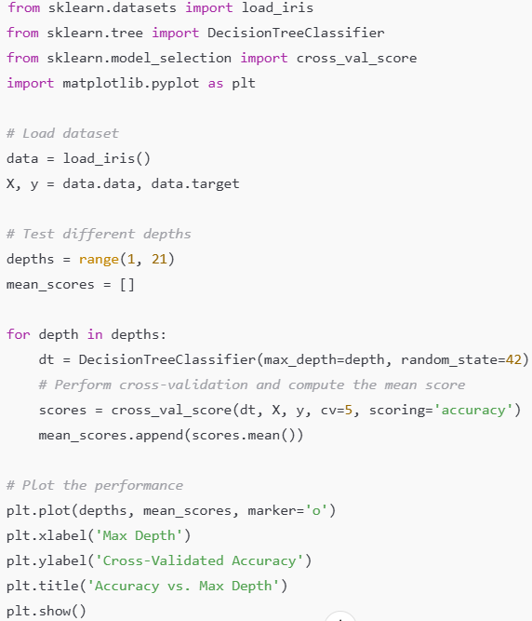

Slide 97
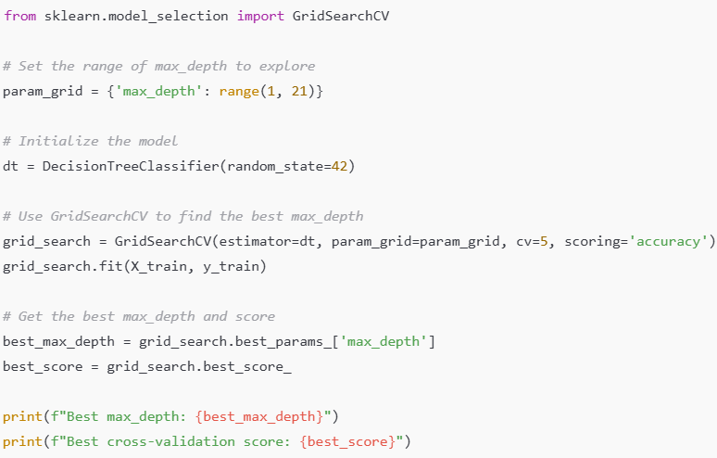

Slide 98
min_samples_split
With every split number of samples also get reduce for analysis.
Thus for higher depth problem of overfitting may occur.
It controls the minimum number of data points a node must have before it can be split further.
If the number of samples in a node is less than this value, the node becomes a leaf and is not split further.
Smaller values: The tree can grow deeper, as nodes with fewer samples can still be split., May lead to overfitting, as the model captures noise in the data.
Larger values: The tree grows shallower because it requires more samples to split., Can help prevent overfitting but might result in underfitting if the value is too high.

Slide 99
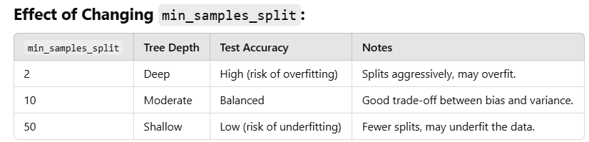


Slide 100
Rule for Decision tree modeling
Rule 1 : Decision trees do not require feature scaling.
Rule 2: Categorical variables can be encoded using Label Encoding
Rule 3 : Check the train test accuracy as there are chance of overfitting or under fitting.
Rule 4 : Treat imbalance data set.
Rule 5: Use feature importance method for model simplification.
Rule 6: Use hyper parameter tuning for deciding max_depth, min_samples_split, or min_samples_leaf
Rule 7 : Outlier treatment because if depth is high may cause issue.

Slide 101
Feature Importance in Decision Trees
Feature importance is calculated based on the reduction in impurity (e.g., Gini Impurity or Entropy) brought by each feature during splits. A higher reduction indicates a more important feature.
For example:
Gini Impurity before the split = 0.5.
Gini Impurity after the split using Feature A = 0.3.
Reduction in Gini Impurity = 0.5 - 0.3 = 0.2 (Feature A's contribution).
Features that reduce impurity more are more important.

Slide 102
Outlier Treatment
Prune the tree by limiting the maximum depth.
Set a minimum number of samples required to split a node.
Analyze feature distributions and handle extreme outliers to improve tree interpretability and performance.

Slide 103
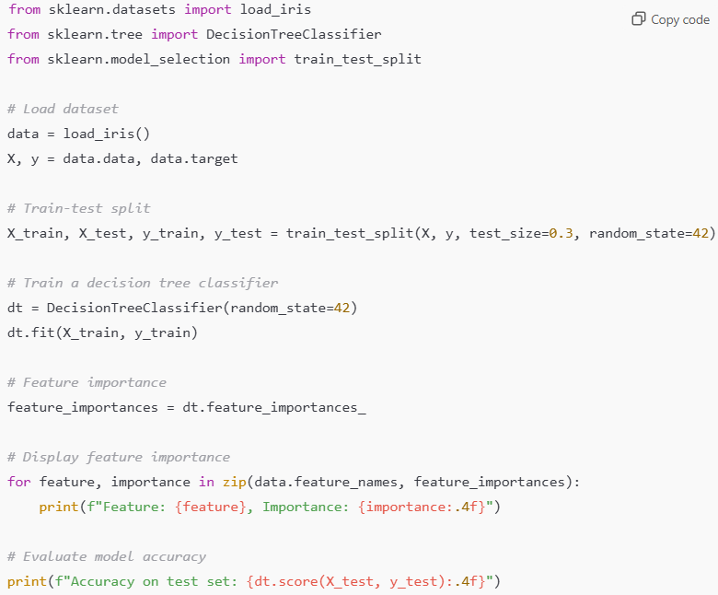

Slide 104
Application of Decision tree
Credit risk modeling.
Customer segmentation.
Fraud detection.
Predictive maintenance.
Loan approval prediction

Slide 105
Key Takeaways
Decision Trees learn IF–ELSE rules
They split data using Gini or Entropy
Splits create axis-parallel boundaries
Easy to interpret but prone to overfitting
Controlled using pruning and hyperparameters

